Slide 1
design variables
Design-based estimation support in RDBES
WKRDB-POP 2019
Edvin Fuglebakk

Slide 2
Design variables RDBES
On each sampling unit (level in hierarchy):
total
sampled
sampProb
selectionMethod
stratification
stratum
clustering
clusterName
selectionMethodCluster
totalClusters
sampledClusters
clusterProb
reasonNotSampled

Slide 3
ESTIMATION
Statistical inference
model based
design based
Frequentist
Bayesian
Assumptions on nature
Assumptions on sampling

Slide 4
Assumptions and verification
Assumptions on nature
Uncontrollable
Often unverifiable
Leads to complexity
Scrutiny inaccessible
Assumptions on sampling
In principle controllable
... But difficult
Scrutiny easy and objective
... At least easier

Slide 5
Design based estimation
Based on assumptions we can control:
Random selection with known probability and known total number of sampling units in population

Slide 6
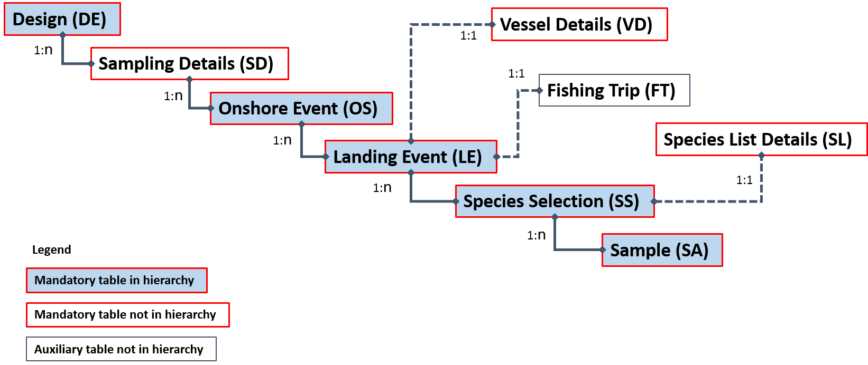
Sampling units (Hierarchies)
Hierarchical sampling imposes correlation structure in data
Reduces effective sample size.
Necessary information also for model based estimation.
Each table in a hiearchy represents a selection of sampling units.
Each table therefore have design variables

Slide 7
Design variables RDBES
On each sampling unit (level in hierarchy):
total
sampled
sampProb
selectionMethod
straification
stratum
clustering
clusterName
selectionMethodCluster
totalClusters
sampledClusters
clusterProb
reasonNotSampled

Slide 8
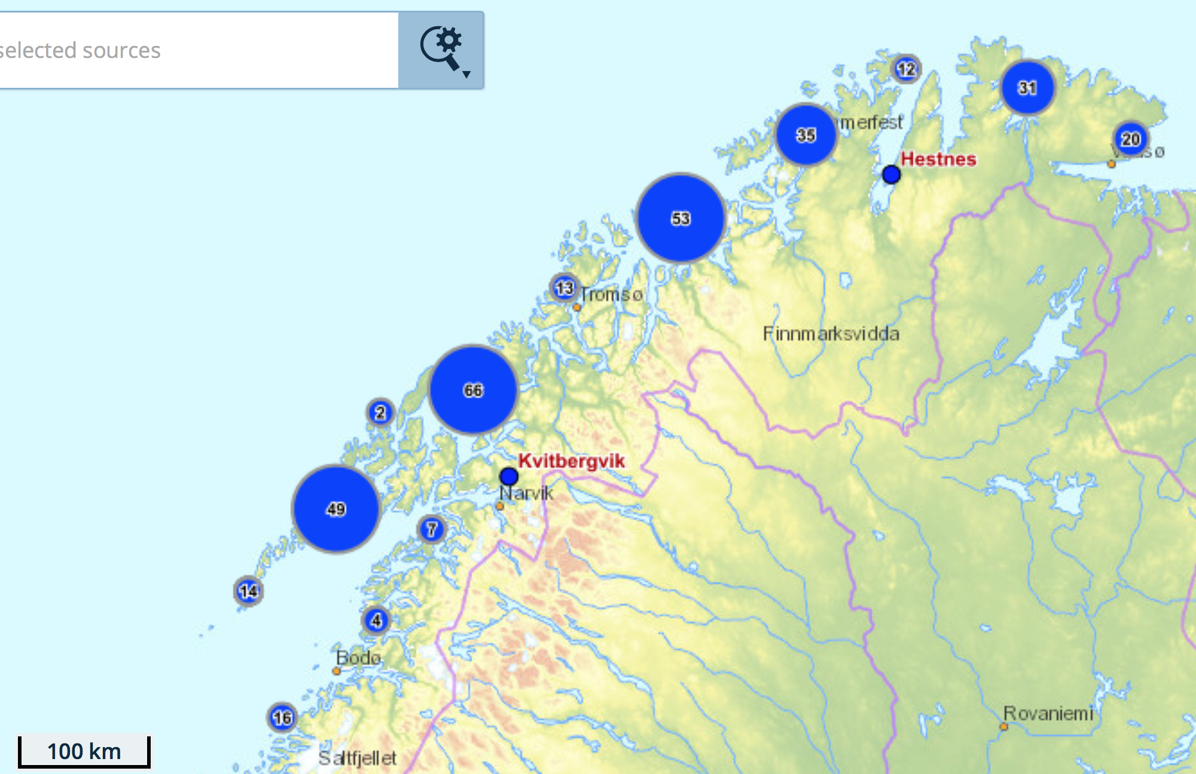
EXAMPLE
Hierarchy 5
PSU: Site-day
SSU: landing
PSUs:
Site 1, Jan 1
Site 2, Jan 1
...
Site 271, Dec 31

Slide 9
BASIC DESIGN VARIABLES
We always need:
Random selection with known probability and known total number of sampling units in population.
total
sampled
sampProb
selectionMethod

Slide 10
EXAMPLE
Hierarchy 5
PSU: Site-day
SSU: landing
OSid | OSnationalLocationName | OSsamplingDate | OStotal | OSsampeld | OSsampProb | selectionMethod
1 | Site 1 | Jan 1 | 98915 | 140 |  | SRSWOR
2 | Site 70 | Feb 3 | 98915 | 140 |  | SRSWOR
3 | Site 112 | Sep 16 | 98915 | 140 |  | SRSWOR
PSUs:
Site 1, Jan 1
Site 2, Jan 1
...
Site 271, Dec 31

Slide 11
EXAMPLE
Hierarchy 5
PSU: Site-day
SSU: landing
PSUs:
Site 1, Jan 1
Site 2, Jan 1
...
Site 271, Dec 31

Slide 12
EXAMPLE
Hierarchy 5
PSU: Site-day
SSU: landing
OSid | OSnationalLocationName | OSsamplingDate | OStotal | OSsampeld | OSsampProb | OSselectionMethod
1 | Site 1 | Jan 1 | 98915 | 140 |  | SRSWOR
2 | Site 70 | Feb 3 | 98915 | 140 |  | SRSWOR
3 | Site 112 | Sep 16 | 98915 | 140 |  | SRSWOR
PSUs:
Site 1, Jan 1
Site 2, Jan 1
...
Site 271, Dec 31
LEid | OSid | LEtotal | LEsampeld | LEsampProb | LEselectionMethod
1 | 1 | 10 | 2 |  | SRSWOR
2 | 1 | 10 | 2 |  | SRSWOR
3 | 2 | 7 | 1 |  | SRSWOR

Slide 13
ZEROES
Need to record zeroes with design based estimation
Unlike ratio estimation and many model based estimations

Slide 14
EXAMPLE
Hierarchy 5
PSU: Site-day
SSU: landing
OSid | OSnationalLocationName | OSsamplingDate | OStotal | OSsampeld | OSsampProb | selectionMethod
1 | Site 1 | Jan 1 | 98915 | 140 |  | SRSWOR
2 | Site 70 | Feb 3 | 98915 | 140 |  | SRSWOR
3 | Site 112 | Sep 16 | 98915 | 140 |  | SRSWOR
4 | Site 9 | Dec 25 | 98915 | 140 |  | SRSWOR
PSUs:
Site 1, Jan 1
Site 2, Jan 1
...
Site 271, Dec 31
LEid | OSid | LEtotal | LEsampeld | LEsampProb | LEselectionMethod
1 | 1 | 10 | 2 |  | SRSWOR
2 | 1 | 10 | 2 |  | SRSWOR
3 | 2 | 7 | 1 |  | SRSWOR
4 | 4 | 0 | 0 |  | SRSWOR

Slide 15
stratification
Sampling Strata: partitioning of the sampling frame
Every sampling unit in the population belong to one exactly strata
We know the population total in each strata
May reduce variance in estimate, does not affect bias in design based estimation
Many possibilites, need flexible system
Text strings controlled by submitter, rather than reference list

Slide 16
EXAMPLE
LEid | OSid | LEtotal | LEsampeld | LEsampProb | LEselectionMethod
1 | 1 | 10 | 2 |  | SRSWOR
2 | 1 | 10 | 2 |  | SRSWOR
3 | 2 | 7 | 1 |  | SRSWOR
LEid | OSid | LEstratification | LEstratum | LEtotal | LEsampeld | LEsampProb | LEselectionMethod
1 | 1 | Yes | Gillnet | 6 | 1 |  | SRSWOR
1 | 1 | Yes | Longline | 3 | 1 |  | SRSWOR
1 | 1 | Yes | D. Seine | 1 | 0 |  | SRSWOR

Slide 17
CLUSTERING
Clusters of some sampling unit
Actually another level in the hiearchy
Many possibilites, need flexible system (like stratification)
Text strings controlled by submitter, rather than reference list
No separate table, noted on the sampling unit that are being clustered

Slide 18
EXAMPLE

Slide 19
EXAMPLE
Region 4
Region 3
Hierarchy 5 w clustering
PSU: Region-weeks
SSU: Site-day
TSU: landing
Region 2
Region 1
PSUs:
Region 1, Week 1
Region 2, Week 1
...
Region 4, Week 52

Slide 20
EXAMPLE
Region 4
Region 3
Hierarchy 5 w clustering
PSU: Region-weeks
SSU: Site-day
TSU: landing
Cluster 2
OSid | OSnationalLocationName | OSsamplingDate | OStotal | OSsampeld | OSsampProb | selectionMethod
1 | Site 1 | Jan 1 | 623 | 7 |  | SRSWOR
2 | Site 5 | Jan 2 | 623 | 7 |  | SRSWOR
3 | Site 112 | Sep 16 | 574 | 7 |  | SRSWOR
Cluster 1
PSUs:
Region 1, Week 1
Region 2, Week 1
...
Region 4, Week 52
OSclustering | OSclusterName | OStotalClusters | OSsampledClusters | OSclustersProb | OSselectionMethodCluster
2-stage | Region1/W1 | 208 | 20 |  | SRSWOR
2-stage | Region1/W1 | 208 | 20 |  | SRSWOR
2-stage | Region2/W38 | 208 | 20 |  | SRSWOR

Slide 21
UNEQUAL PROBABILITY
We always need (for unbiased estimate):
Random selection with known probability and known total number of sampling units in population.
Distribution of sampling effort may reduce variance in estimate
Can be controlled by unequal probability sampling

Slide 22
EXAMPLE
Region 4
0.27%
Region 3
0.27%
Hierarchy 5 w clustering
PSU: Region-weeks
SSU: Site-day
TSU: landing
Region 2
0.27%
Region 1
3%/w Jan-April
0.27% May-Dec
PSUs:
Region 1, Week 1
Region 2, Week 1
...
Region 4, Week 52

Slide 23
EXAMPLE
Region 4
0.27%
Region 3
0.27%
Hierarchy 5 w clustering
PSU: Region-weeks
SSU: Site-day
TSU: landing
Cluster 2
0.27%
OSid | OSnationalLocationName | OSsamplingDate | OStotal | OSsampeld | OSsampProb | selectionMethod
1 | Site 1 | Jan 1 | 623 | 7 |  | SRSWOR
2 | Site 5 | Jan 2 | 623 | 7 |  | SRSWOR
3 | Site 112 | Sep 16 | 574 | 7 |  | SRSWOR
Cluster 1
3%/w Jan-April
0.27% May-Dec
PSUs:
Region 1, Week 1
Region 2, Week 1
...
Region 4, Week 52
OSclustering | OSclusterName | OStotalClusters | OSsampledClusters | OSclustersProb | OSselectionMethodCluster
2-stage | Region1/W1 | 208 | 20 | 0.3 | UPSWOR
2-stage | Region1/W1 | 208 | 20 | 0.3 | UPSWOR
2-stage | Region2/W38 | 208 | 20 | 0.027 | UPSWOR

Slide 24
Implementation of design
Does not always go according to plan
Need to record deviations from design
Can record reason for not sampling
Assumptions on sampling
In principle controllable
... But difficult
Scrutiny easy and objective
... At least easier

Slide 25
EXAMPLE
OSid | OSnationalLocationName | OSsamplingDate | OStotal | OSsampeld | OSsampProb | selectionMethod
1 | Site 1 | Jan 1 | 98915 | 140 |  | SRSWOR
2 | Site 70 | Feb 3 | 98915 | 140 |  | SRSWOR
3 | Site 112 | Sep 16 | 98915 | 140 |  | SRSWOR
4 | Site 9 | Dec 25 | 98915 | 140 |  | SRSWOR
Hierarchy 5
PSU: Site-day
SSU: landing
PSUs:
Site 1, Jan 1
Site 2, Jan 1
...
Site 271, Dec 31
LEid | OSid | LEtotal | LEsampeld | LEsampProb | LEselectionMethod | LEnoSampReason
1 | 1 | 10 | 2 |  | SRSWOR
2 | 1 | 10 | 2 |  | SRSWOR
3 | 2 | 7 | 1 |  | SRSWOR
4 | 4 | 3 | 0 |  | SRSWOR | Non-response – sampling Error

Slide 26
Partial probabilistic design
Hierarchies need to be identified for all kinds of estimations
If totals can be identified from external sources (logbooks or landings):
Design based estimates under assumptions may be calculated
Design can be gradually improved by working on selection routines.

Slide 27
EXAMPLE
OSid | OSnationalLocationName | OSsamplingDate | OStotal | OSsampeld | OSsampProb | selectionMethod
1 | Site 1 | Jan 1 |  | 140 |  | NPAH
2 | Site 70 | Feb 3 |  | 140 |  | NPAH
3 | Site 112 | Sep 16 |  | 140 |  | NPAH
4 | Site 9 | Dec 25 |  | 140 |  | NPAH
Hierarchy 5
PSU: Site-day
SSU: landing
PSUs:
Site 1, Jan 1
Site 2, Jan 1
...
Site 271, Dec 31
LEid | OSid | LEtotal | LEsampeld | LEsampProb | LEselectionMethod | LEnoSampReason
1 | 1 | 10 | 2 |  | SRSWOR
2 | 1 | 10 | 2 |  | SRSWOR
3 | 2 | 7 | 1 |  | SRSWOR

Slide 28
Design variables RDBES
On each sampling unit (level in hierarchy):
total
sampled
sampProb
selectionMethod
straification
stratum
clustering
clusterName
selectionMethodCluster
totalClusters
sampledClusters
clusterProb
reasonNotSampled

Slide 29
Norwegian port sampling no 64N
Norwegian port sampling no 64N is a sampling program which can be viewed as a partial probabilistic design:
Hierarchies well identified
Sampling frame and zero samples can be identified post-hoc from sales notes.

Slide 30
EXAMPLE
Day trips no 64N
Contact vessels at sea
Agree to meet at landing site
Sample at landing site before sale
Day trips no 64N
Contact landing site
Agree to sample incoming vessels
Sample at landing site after sale

Slide 31
EXAMPLE
DEid | DErecordType | DEsamplingScheme | DEyear | DEstratum | DEhierarchyCorrect | DEhierarchy
1 | DE | Norway IMR port-sampling | 2016 | Fresh/COD-POL-HAD/N64 | Yes | 5

Slide 32
EXAMPLE
OSid | OSnationalLocationName | OSsamplingDate | OStotal | OSsampeld | OSsampProb | OSselectionMethod | OSstratidication | OSstratum
1 | Site 1 | Jan 1 | 9062 | 40 |  | SYSS | Yes | Q1
2 | Site 70 | Feb 3 | 9062 | 40 |  | SYSS | Yes | Q1

Slide 33
EXAMPLE
LEid | OSid | LEstratification | LEstratum | LEtotal | LEsampeld | LEsampProb | LEselectionMethod
1 | 1 | Yes | Gillnet | 6 | 1 |  | SRSWOR
1 | 1 | Yes | Longline | 3 | 1 |  | SRSWOR
1 | 1 | Yes | D. Seine | 1 | 0 |  | SRSWOR

